Slide 1
Glow: Graph Lowering Compiler Techniques for Neural Networks

Slide 2
Table of contents
Explanation about deep learning compiler
What is Glow?
Evaluation/Conclusion
Quantization
What is Quantization?
Profile-Guided Quantization
Compiler Optimizations for Quantization
High-Level IR
Low-Level IR
Operator Stacking
Reference

Slide 3
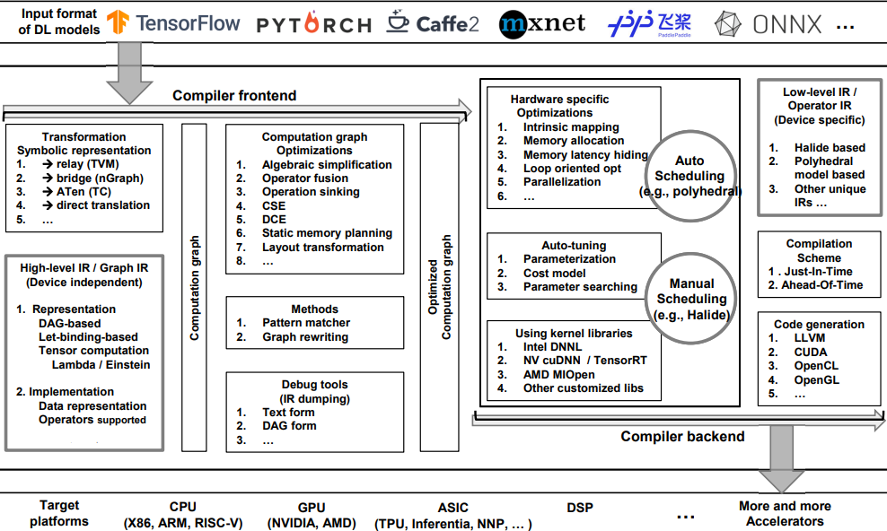
Deep Learning Compiler ?
Basically, DL compilers take the DL models described in different DL frameworks as input, and then generate optimized codes for diverse DL hardware as output[1]

Slide 4
Glow??
Developed by Facebook
Basically, DL compilers take the DL models described in different DL frameworks as input, and then generate optimized codes for diverse DL hardware as output[1]

Slide 5
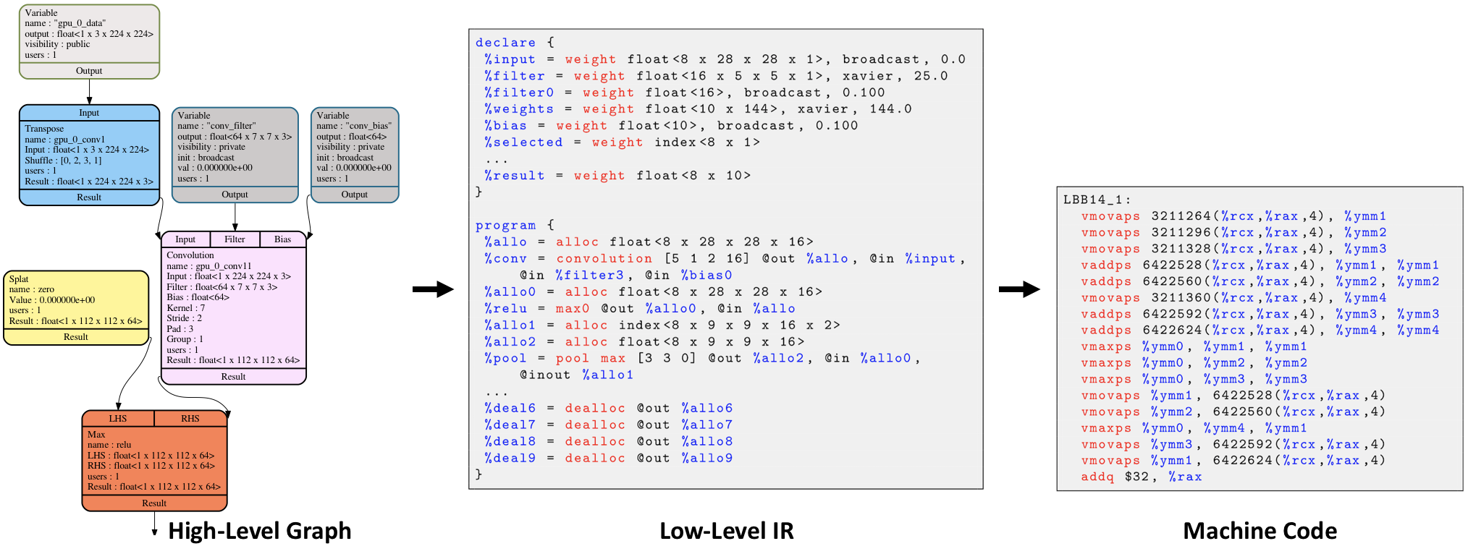
Deep learning models..

Slide 6
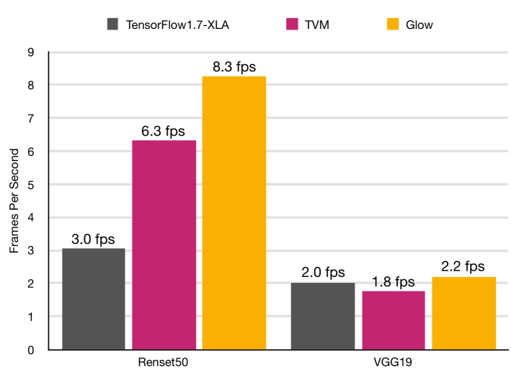
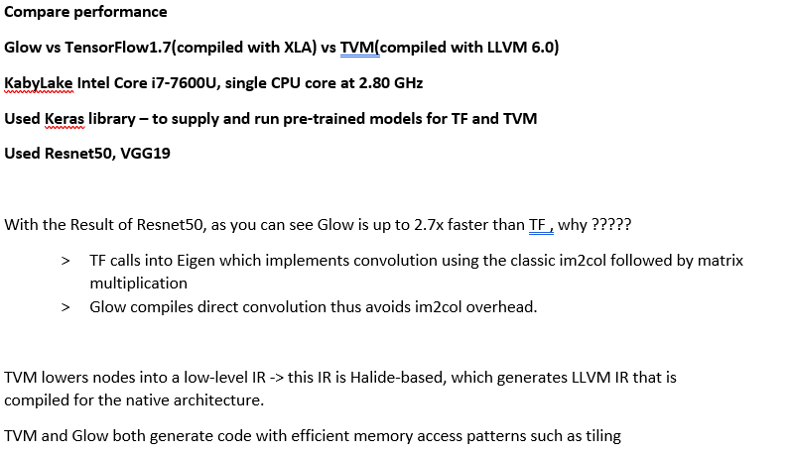
Evaluation / Conclusion

Slide 7
Evaluation / Conclusion
This paper presented the design of Glow, a ML compiler for heterogeneous hardware.
Glow lowers the compute graph of neural networks to multi-level strongly-type IR , enabling analyses and optimizations appropriate for each level to efficiently and scalably target many backends

Slide 8
Quantization

Slide 9
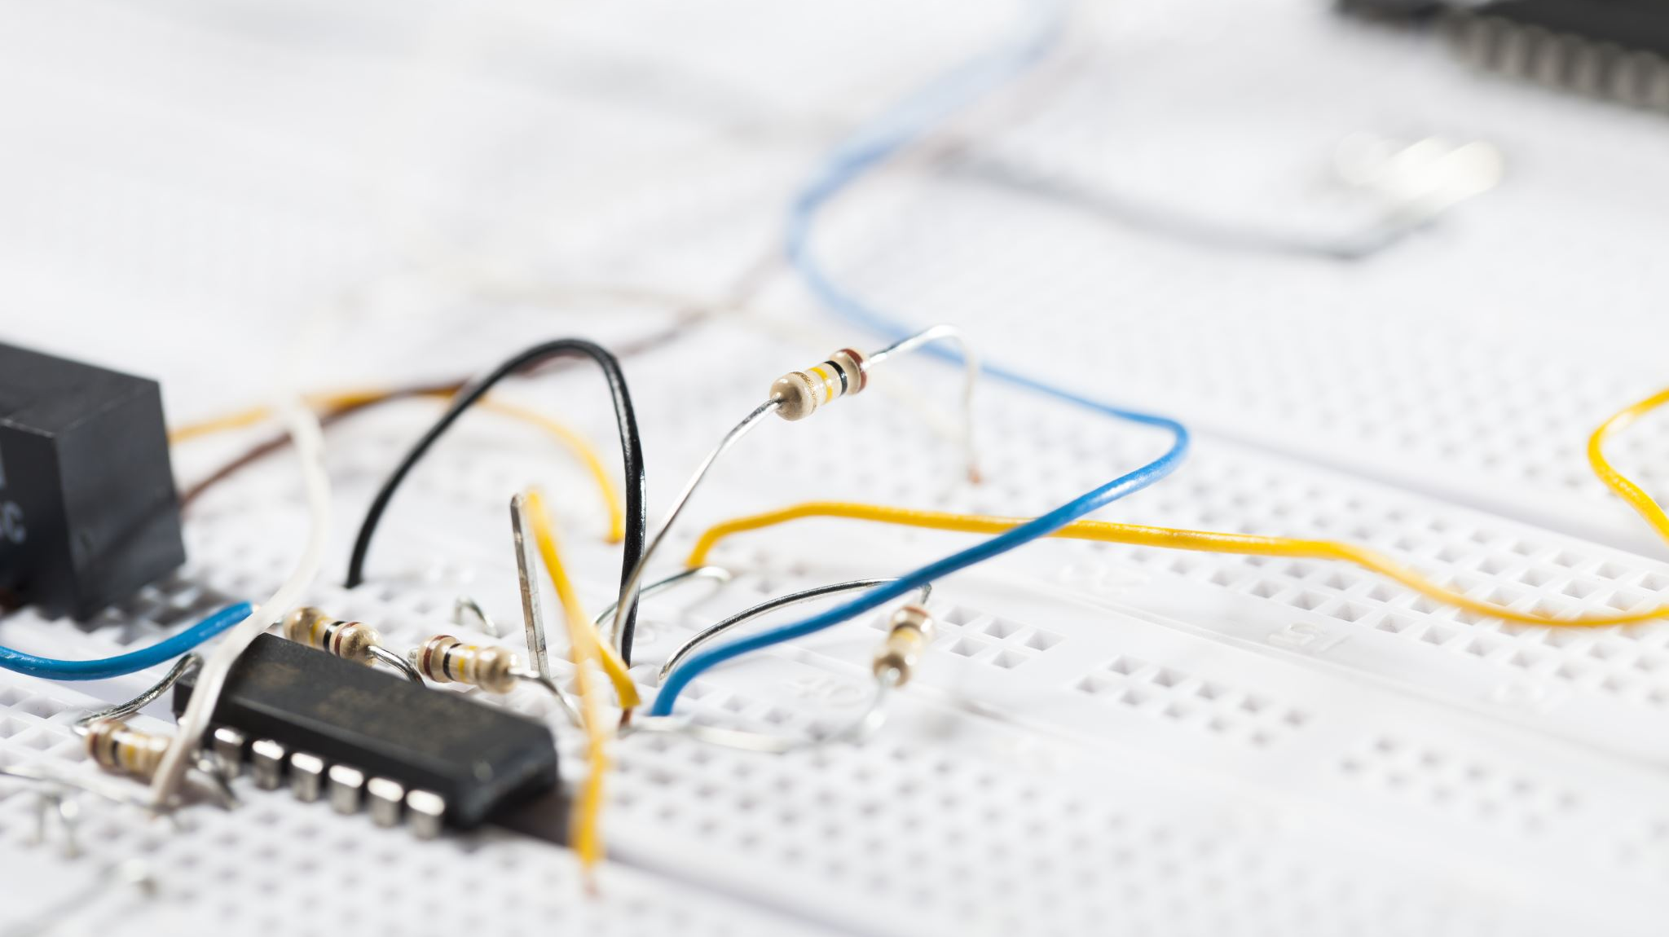
What is Quantization?
Quantization is the process of converting a neural network from floating point to integer arithmetic. By using small integers its is more efficient than the computation of full-width floating point numbers
In Glow convert floating point based networks into signed 8bit integer networks. (fp32 -> int8)
It can be considered for model simplification.
Very effective optimization

Slide 10
uniform
Method of fp32-> int8 mapping
Non-uniform
Mapping in linear way
Generally using it when you considering computational benefit
Compress and then mapping irregularly by using codebook -> complicated
When compiler generate code without help of extra hardware, it is hard by using non-uniform way
By compression , can be fit in Sram in small IOT device

Slide 11

Profile-Guided Quantization
observing execution during inference to estimate the possible numeric range for each stage of the neural network.
Glow’s quantization conversion works using two-phase process

Slide 12
Profile-Guided Quantization
First, statically instrument the network with special profiling nodes that record the ranges of activations that low in the network, optimize the network including these profiling nodes, and then run inference
Then recompile the network using this profile information to convert the network into a quantized form, allowing for static optimization of the quantized graph
Then convert portions of the network into islands of integer computation and aim to generate outputs in the range that the original floating-point network produces

Slide 13
Compiler Optimizations for Quantization
Compiler optimization -> transform the compute graph and make it more efficient
First minimize the number of conversions between floating-point tensors and integer tensors ,in both directions.
Second, neural network contains “rescale” nodes that change the range of integers.
Third, possible to rescale the values in the network in order to allow fast hardware implementations of the quantized operations.

Slide 14
High-Level IR
Dataflow node-based graph representation
It’s a simple graph that allows basic transformations, such as replacing all uses of some node with another node, or modifying the content of input tensors known at compile time

Slide 15
Low-Level IR
The low-level IR enables a different kind of target independent optimizations that are not possible with the high-level graph format.

Slide 16
glow/IR.md at master · pytorch/glow (github.com) for additional information about High or Low-level IR of Glow Compiler

Slide 17
Operator Stacking
For optimization?
Instead of loading CPU every time in case of iterate over a large buffer, Glow stacks operators and performs a few data-parallel operators one after the other on the same memory location.
Similar to operator fusion

Slide 18
References
[1] The Deep Learning Compiler: A Comprehensive Survey MINGZHEN LI , YI LIU , XIAOYAN LIU , QINGXIAO SUN , XIN YOU , HAILONG YANG, ZHONGZHI LUAN , LIN GAN , GUANGWEN YANG , and DEPEI QIAN , Beihang University and Tsinghua University
[2] https://www.youtube.com/watch?v=mDefFU7rbV0&t=62s , https://www.youtube.com/watch?v=JV31xwqJUKI&t=4s / Quantization presentation by
Ph.D Jemin Lee(Senior researcher), ETRI
[3] glow/IR.md at master · pytorch/glow (github.com)

